Slide 1

INDIAN CRIMES
DONE BY:
SANTOSHPRASAD D-E0119050
SAJETH SA-E0119027
KANNAN T-E0219032
DATA ANALYSIS
Guided by: Dr. Senthil.J
Faculty Mentor : Prof. Prabu Kavin
Prof. Nirmala Balasundaram

Slide 2

PROBLEM STATEMENT
To plot graphs using the Indian-crime dataset for the years 1998-2013 in Tableau.
To analyse the crime rates of different regions in India

Slide 3
DATA SET-Indian Crime
Dataset Details
Dataset: Indian-crime
Source: Kaggle
Year: 1988-2013
Main Contents
Assault_on_women , Dacoity , Hurt , Kidnapping_and_abduction , Murder , Other_crimes_against_SC , Prevention_of_atrocities,Protection_of_civil rights, Robberies , Arson, District, State/Ut , Year.

Slide 4
TOOLS INCORPORATED
Tableau for Data Visualization.
Amazon cloud - hosting a website.
My SQL for storing and retrieving of data.
HTML5,CSS3 and JavaScript for the website.

Slide 5
INDIAN CRIME WEBSITE
HOME PAGE:
Graphs on queries
Quick maps
Navigation Bar
Projects
Quick maps
Facts

Slide 6
INDIAN CRIME WEBSITE
Contents of the Facts page
POA
ARSON CRIME
HARASSMENT
DACOITY
PCR

Slide 7
QUERIES AND GRAPHS

Slide 8
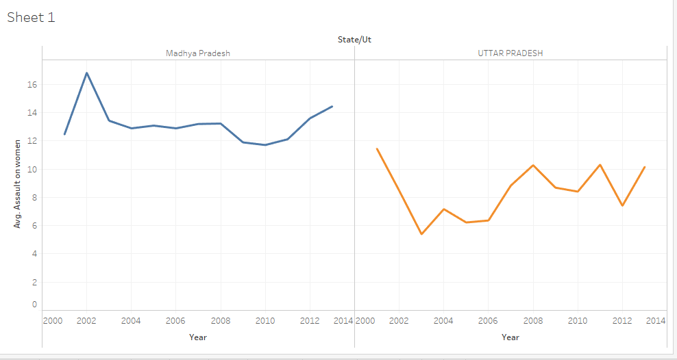
1. Compare the average number of assault on women in the states MP and UP

Slide 9
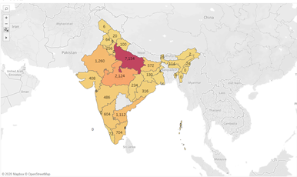
2.Which of the states and union territories have the highest number of murder cases throughout the years 1998-2013?

Slide 10
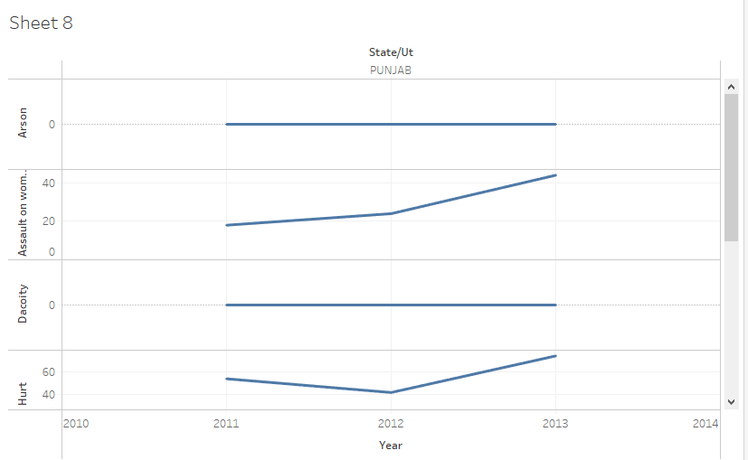
3.What is the trend of all crimes of the Union Territory Delhi within the years 2011-2013?

Slide 11
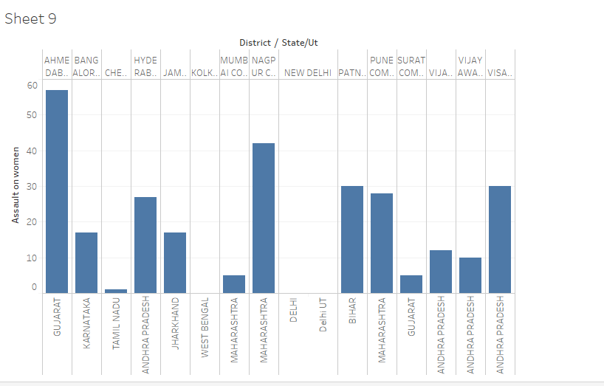
4.Among 13 metropolitan cities of India, which city has highest assaults on women

Slide 12
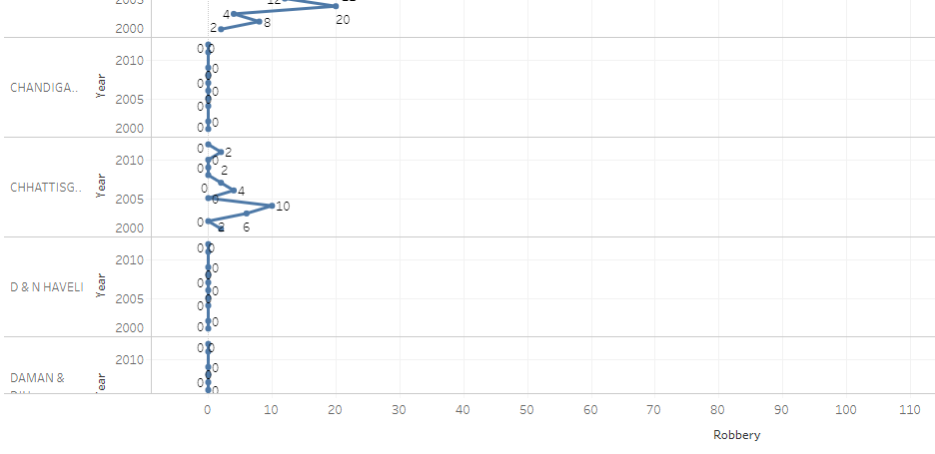
5.In which year(2001-2012), and state did the highest number of robberies occur in India ?

Slide 13
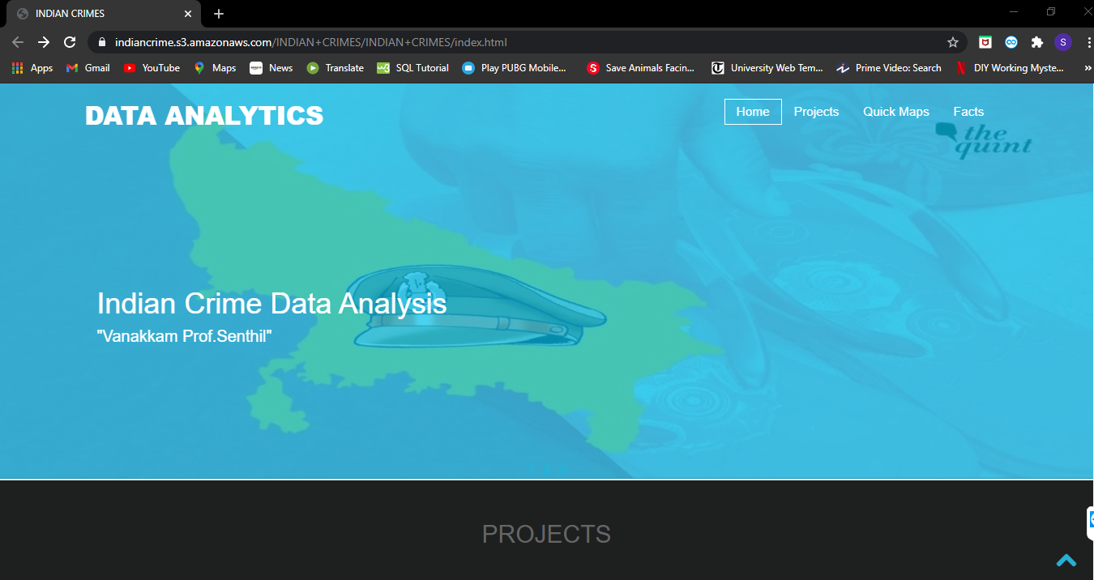
WEBSITE - HOMEPAGE

Slide 14
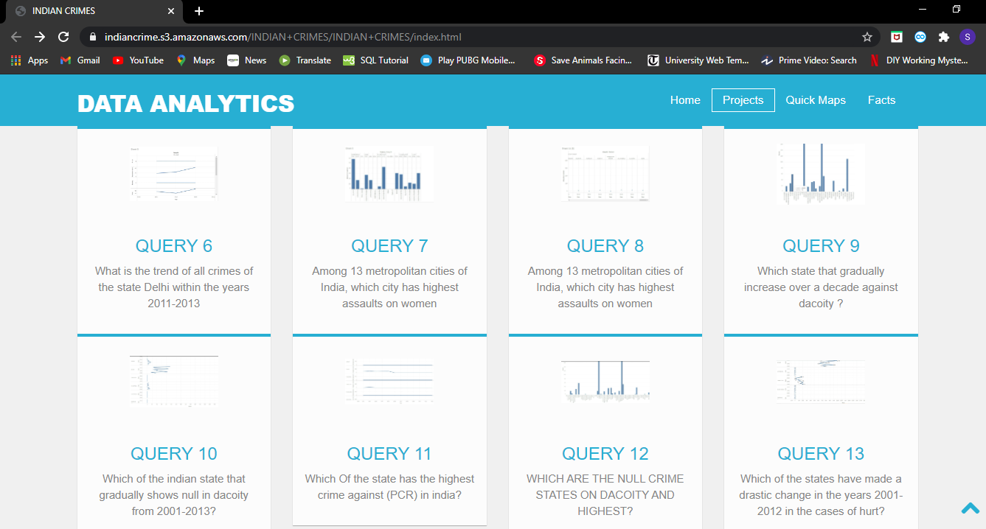
PROJECTS

Slide 15
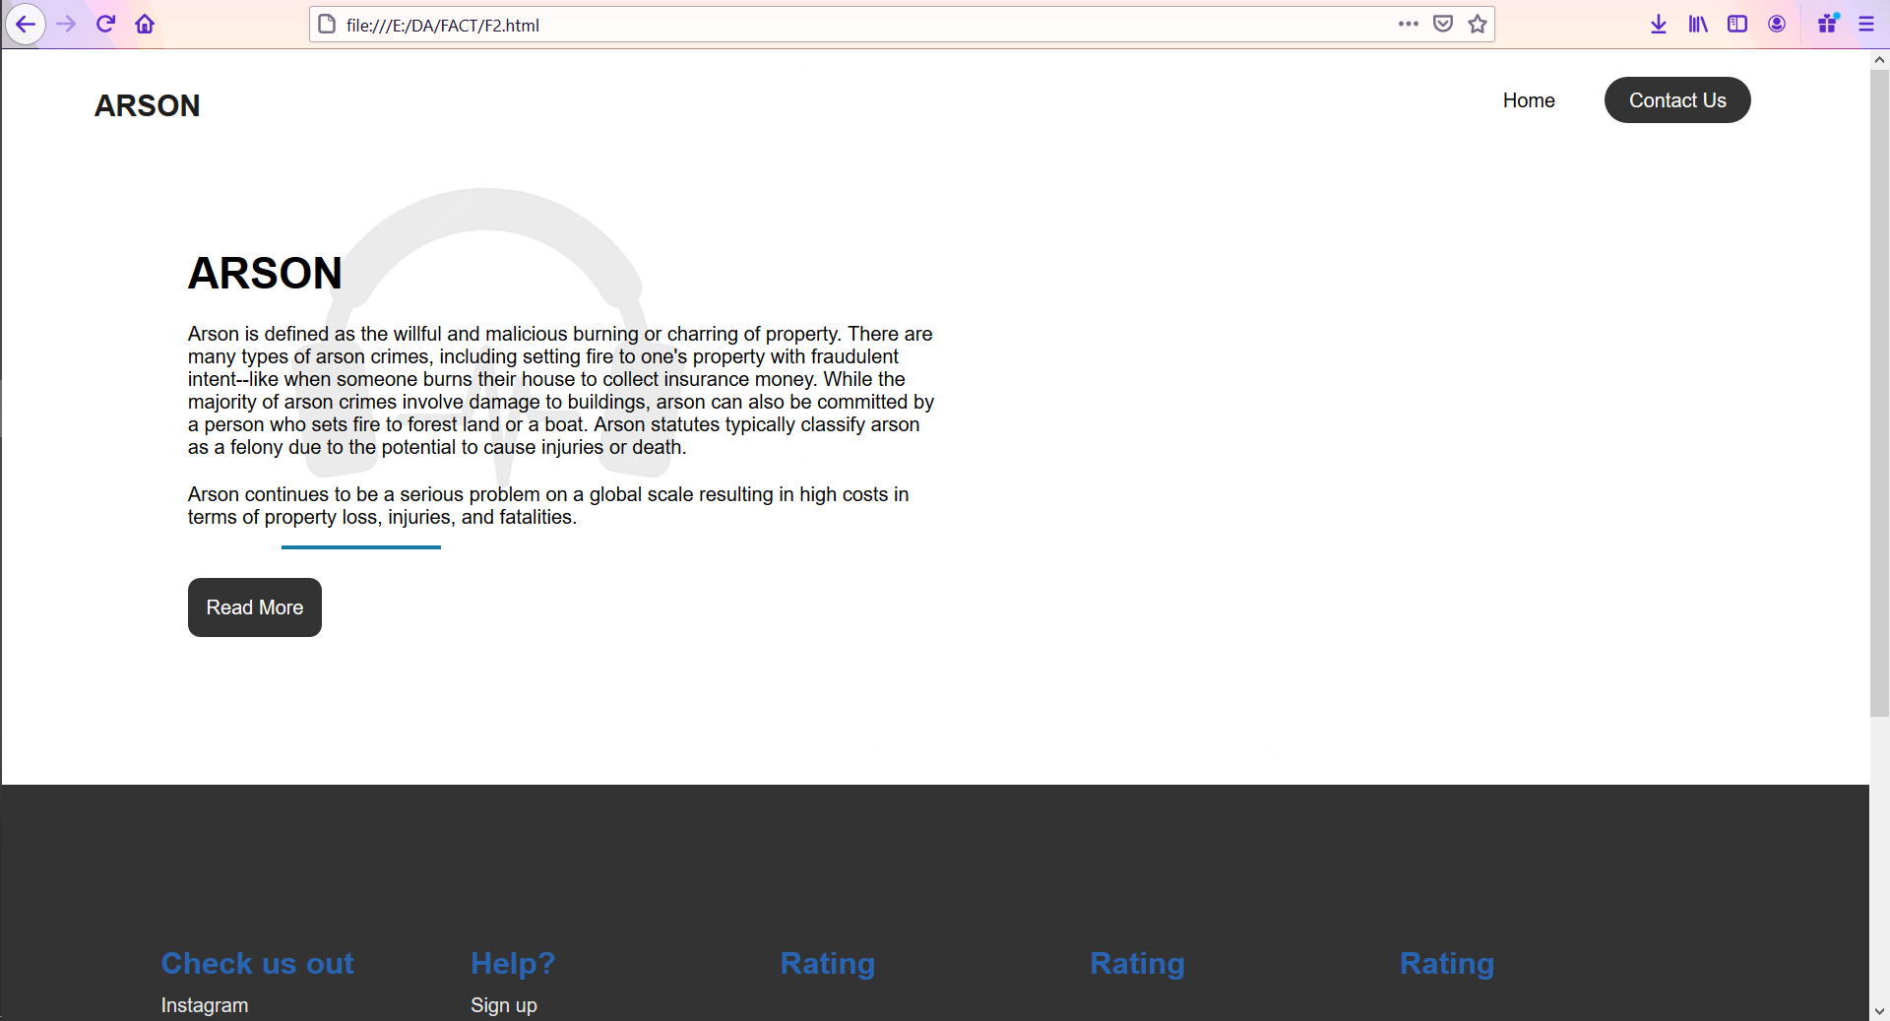
FACTS

Slide 16
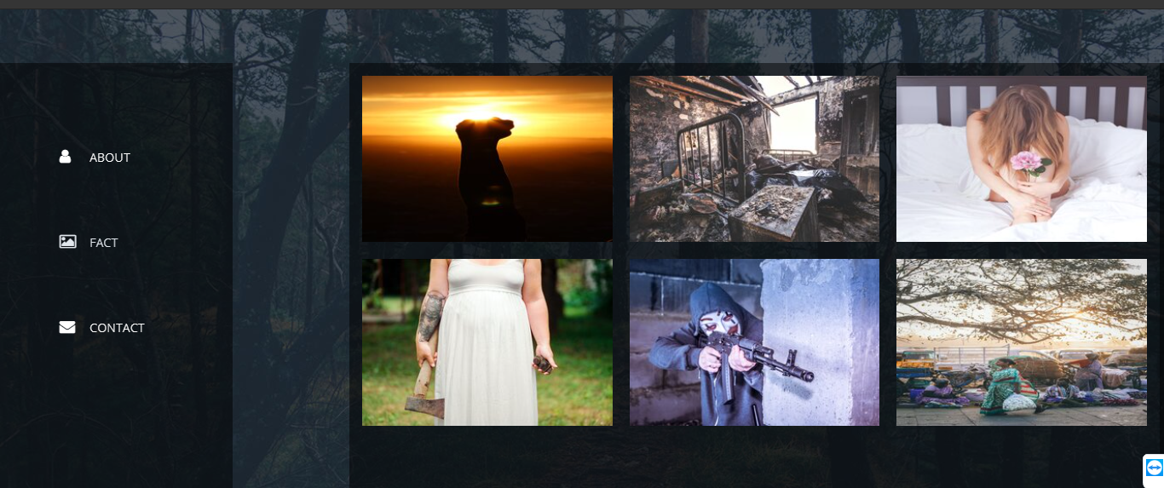
FACTS PAGE

Slide 17
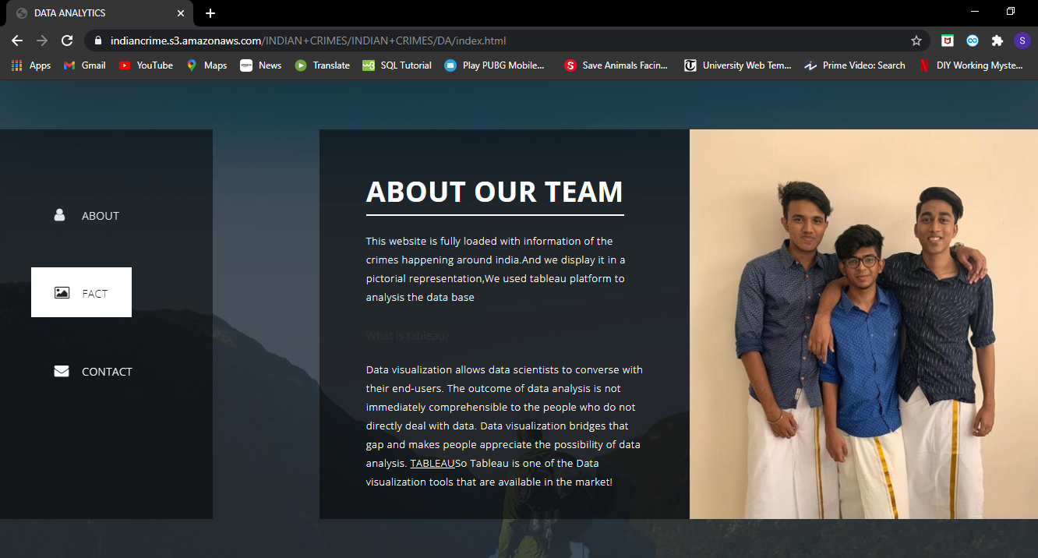
ABOUT US

Slide 18
WEBSITE HOSTING-AWS
Steps
Creating a bucket for static website hosting
Editing s3 block public access setting
Adding a bucket policy
Testing the website endpoint
https://indiancrime.s3.amazonaws.com/INDIAN+CRIMES/INDIAN+CRIMES/index.html

Slide 19
FUTURE SCOPE
Age of diagrams and graphs dependent on client input.
Upgrade the site further outwardly.
Live DataStream

Slide 20
REFERENCES
Links referred to for Tableau and MySQL
https://www.youtube.com/watch?v=Bl58YtVoCDk&feature=share
https://www.youtube.com/watch?v=WmGgxTpGs_8&feature=share
Links referred to for hosting
https://www.youtube.com/watch?v=BpFKnPae1oY&feature=share (AWS hosting)
Sources of the Datasets
https://www.kaggle.com/ (Indian-crime dataset)

Slide 21
THANK YOU

